Slide 1
BUS BRANDING

Slide 2
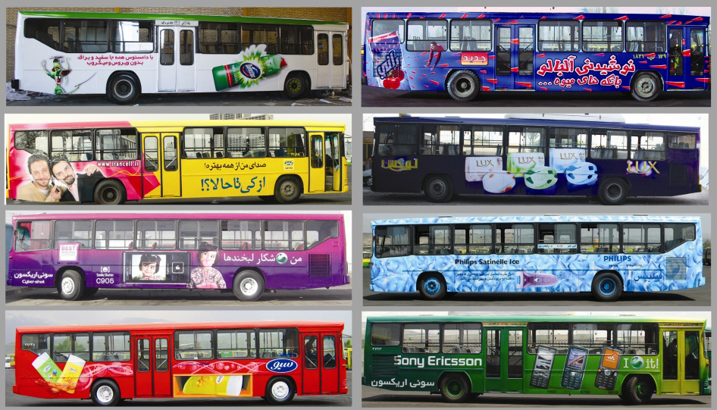

Slide 3
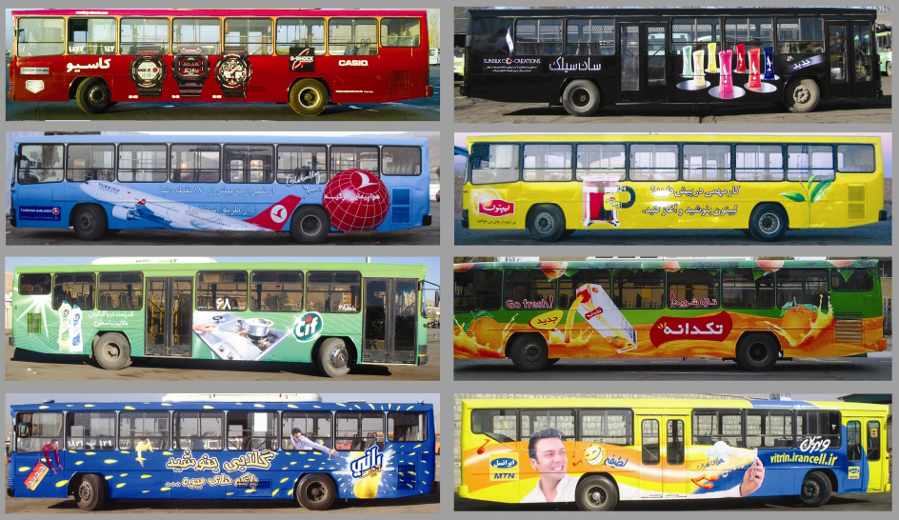

Slide 4
