Slide 1
PR ACTIVITIES

Slide 2
NESTLE
Background
Several years ago, several leading newspapers in Iran published stories that speculated that
some companies such as NOKIA and NESTLE had relationships with Israel.
Challenges and Issues
Negative perception of Nestle in the media
Government ban on Nestle products; advertising and production
Affected consumer impressions of Nestle
Solution
Disseminated a series of press releases that positioned Nestle as having a strong presence across several Islamic countries - investment in growing local economies
Reinforced Nestle's image as a ‘Made in Switzerland’ brand
Built strong relationships with key media and influencers

Slide 3
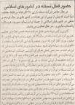
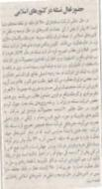
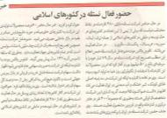

Slide 4
IRANCELL
Background
Following its entry as the second largest telecommunications operator, MTN-Irancell
faced several problems varying from quality of coverage to costs and poor after-sales
service.
Challenges and Issues
Negative perception amongst consumers and media about Irancell’s offerings
Positioning as the second largest player started weakening
Aggressive competitive positioning by MCI
Solution
Irancell hosted a press conference to highlight new and improved offerings
One on one interviews arranged for key Irancell spokespeople with tier one media to build relationships and increase awareness
Specialized events organized (joint events with Nokia)
Notes:
Irancell has been an exclusive client since its launch for all PR and marketing related activities

Slide 5
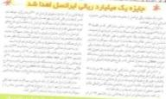
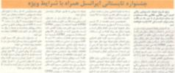

Slide 6
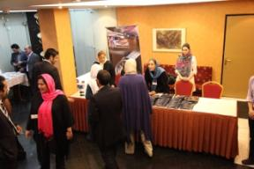
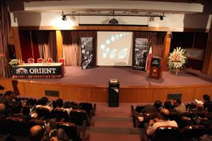
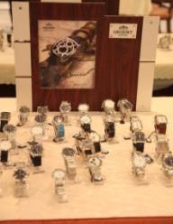
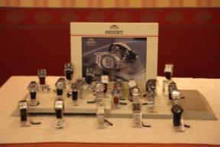
ORIENT

Slide 7
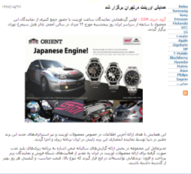
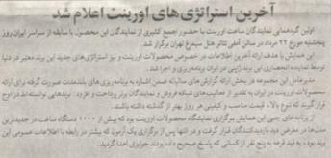
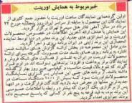

Slide 8
SONY ERICSSON
20 Journalists from different media were invited
18 Journalists were attended at the conference
3 guests were coming from Pars Camtel
Holding question & answer interview at the end of the conference
Journalists were trained to play bowling by a coach
Journalists play bowling

Slide 9
Total No of Ad in paper & website: 28
Total Ad value: USD 34,045
Sony Ericsson F305 and Motiolympics final program was introduced on TV
Channel: IRIB 2
Title Of Program: Roz Az No
Date: 20 – August – 2009
Duration of Introduction: 15-Minutes
Executer: Ms. Akefian

Slide 10
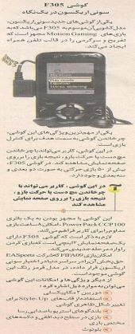
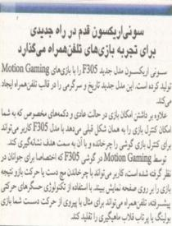
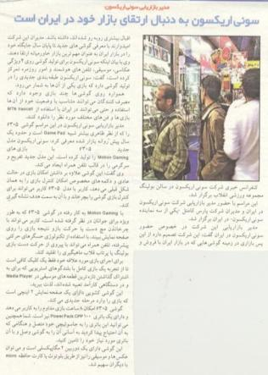
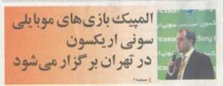

Slide 11
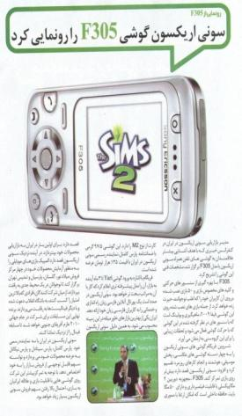
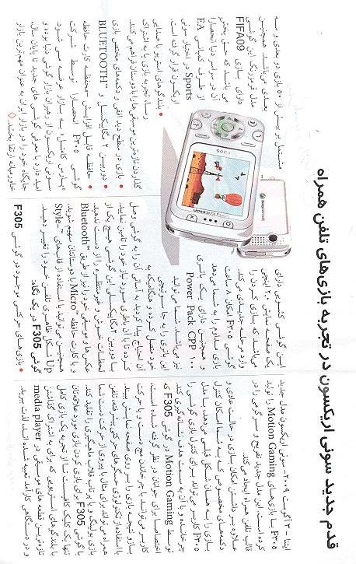

Slide 12
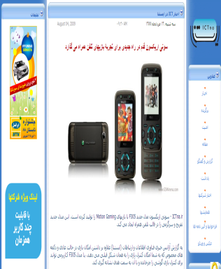
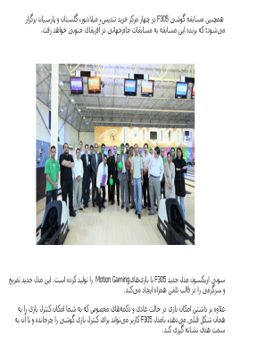

Slide 13
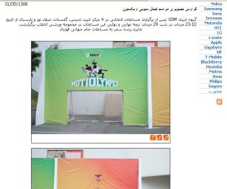
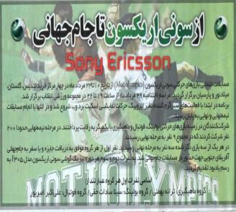
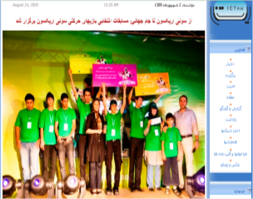
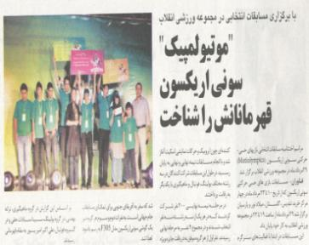

Slide 14
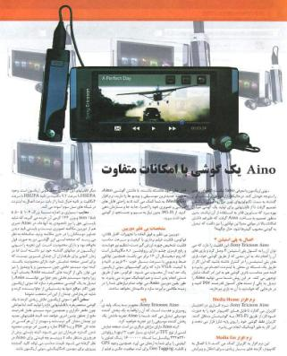
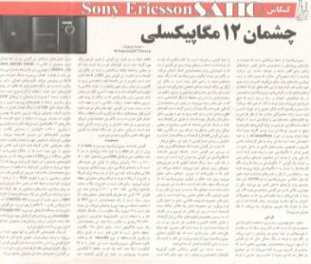
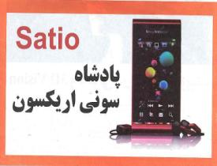
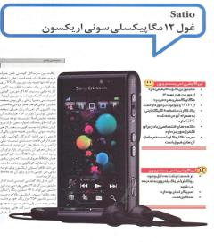
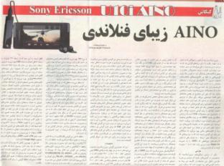

Slide 15
